Slide 1

AI-Driven Banking Risk & Loan Performance Analytics Dashboard
Developing a comprehensive understanding of risk analytics in banking and financial services to minimize the risk of losing money while lending to customers through data-driven decision making.

Slide 2
CHALLENGE
The Problem We're Solving
Banks face a critical challenge: how to make informed lending decisions that minimize financial risk while serving customers effectively. Traditional methods often lack the data-driven insights needed to accurately assess an applicant's likelihood of loan repayment.
Key Capabilities
Real-time risk assessment
Applicant profile analysis
Data-driven loan decisions
Comprehensive client insights
Our solution leverages Power BI's latest tools to create interactive dashboards that analyze applicant profiles comprehensively. These dashboards enable banks to make confident approval decisions based on concrete data patterns and risk indicators, transforming raw banking data into actionable intelligence.

Slide 3
Understanding Our Dataset
The foundation of our risk analytics system is a comprehensive dataset containing detailed bank and client information. This multi-table structure provides a 360-degree view of banking relationships and client profiles.
Banking Relationship
Client-Banking
Demographics
Investment Advisor
Client-bank connection details and account types
Transaction history and engagement metrics
Gender, location, and personal information
Advisory relationships and guidance data
Period
Time-based analysis and trends
These tables are interconnected through primary and foreign keys, enabling comprehensive cross-referential analysis and deep insights into client behavior and risk profiles.

Slide 4

DATA ENGINEERING
Data Cleaning & Transformation
We implemented sophisticated data cleaning processes to enhance the dataset's analytical value. Three critical transformations were applied to create actionable insights from raw banking data.
01
02
Engagement Timeframe
Engagement Days
Created timeline categories based on client tenure: <1 year, <1.5 years, <5 years, <10 years, and >10 years, providing clear segmentation of client relationships.
Calculated the exact number of days from joining date to present using DATEDIFF function, enabling precise tenure analysis and relationship maturity assessment.
03
04
Income Bands
Processing Fees
Categorized estimated income into Low (<$100K), Mid ($100K-$300K), and High (>$300K) bands for risk stratification and targeted analysis.
Mapped fee structures to processing rates: High (0.05), Mid (0.03), Low (0.01), automating fee calculations across all client accounts.

Slide 5



Power BI Functions Powering Our Analytics
SUM
SWITCH
DATEDIFF
Aggregates all numbers in a column, returning decimal totals for financial calculations.
Evaluates expressions against value lists, returning conditional results for categorization.
Calculates interval boundaries between dates for tenure and engagement analysis.
Bank Deposit =
SUM('Clients - Banking'[Bank Deposits])
Income Band =
SWITCH(TRUE(),
[Estimated Income] < 100000, "Low",
[Estimated Income] < 300000, "Mid",
"High")
Engagement Days =
DATEDIFF([Joined Bank], TODAY(), DAY)
DISTINCTCOUNT
Counts unique values in a column, essential for client counting and deduplication.
Total Clients =
DISTINCTCOUNT('Clients - Banking'[Client ID])
SUMX
Evaluates expressions row-by-row before summing, perfect for calculated totals.
Total Fees =
SUMX('Clients - Banking',
[Total Loan] * [Processing Fees])

Slide 6

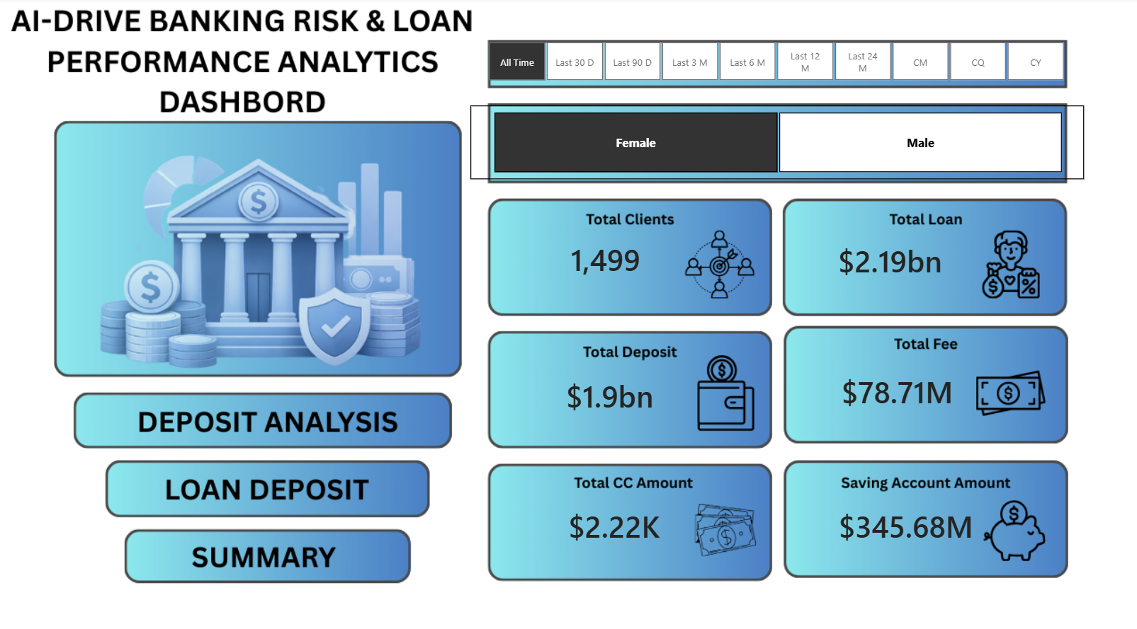
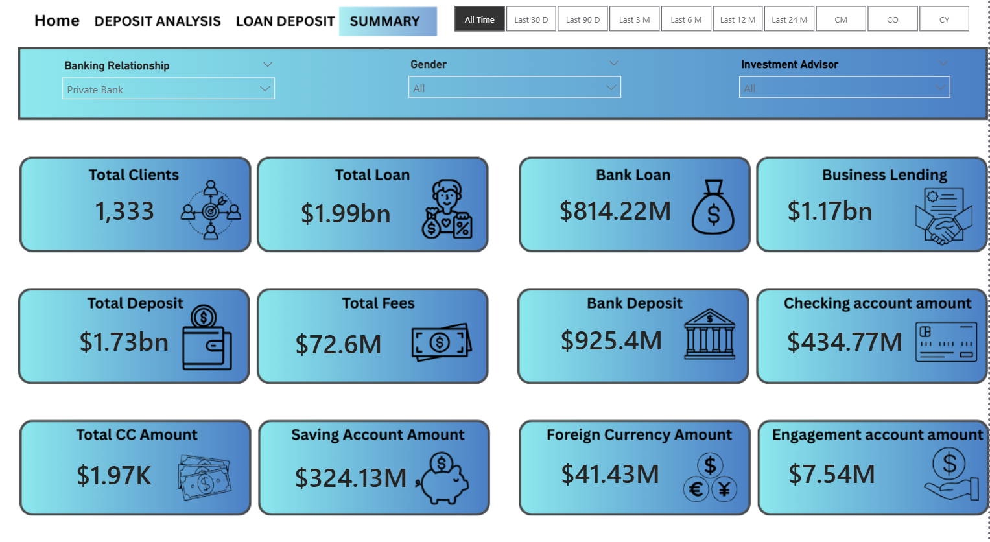

Key Performance Indicators
Our dashboard tracks 12 critical KPIs that provide comprehensive insights into banking operations, client relationships, and financial health. These metrics enable real-time risk assessment and strategic decision-making.
1,333
$1.99bn
$814.22M
Total Clients
Total Loan
Bank Loan
Distinct count of all banking clients
Combined bank loans, business lending, and credit card balances
Total loan amounts to be repaid by clients
$1.17bn
Business Lending
Loans provided to small businesses

Slide 7
Deposit & Account Metrics
Total Deposit
Bank Deposit
Savings Account
Foreign Currency
$1.73bn
$925.4M
$324.13M
$41.43M
Sum of all deposit types: bank deposits, savings, foreign currency, and checking accounts
Money deposited directly into bank accounts
Interest-bearing deposit accounts
Accounts held in non-domestic currencies
Total Fees
Checking Accounts
$72.6M
$434.77M
Account setup and maintenance charges
Funds in accounts for daily transactional needs

Slide 8

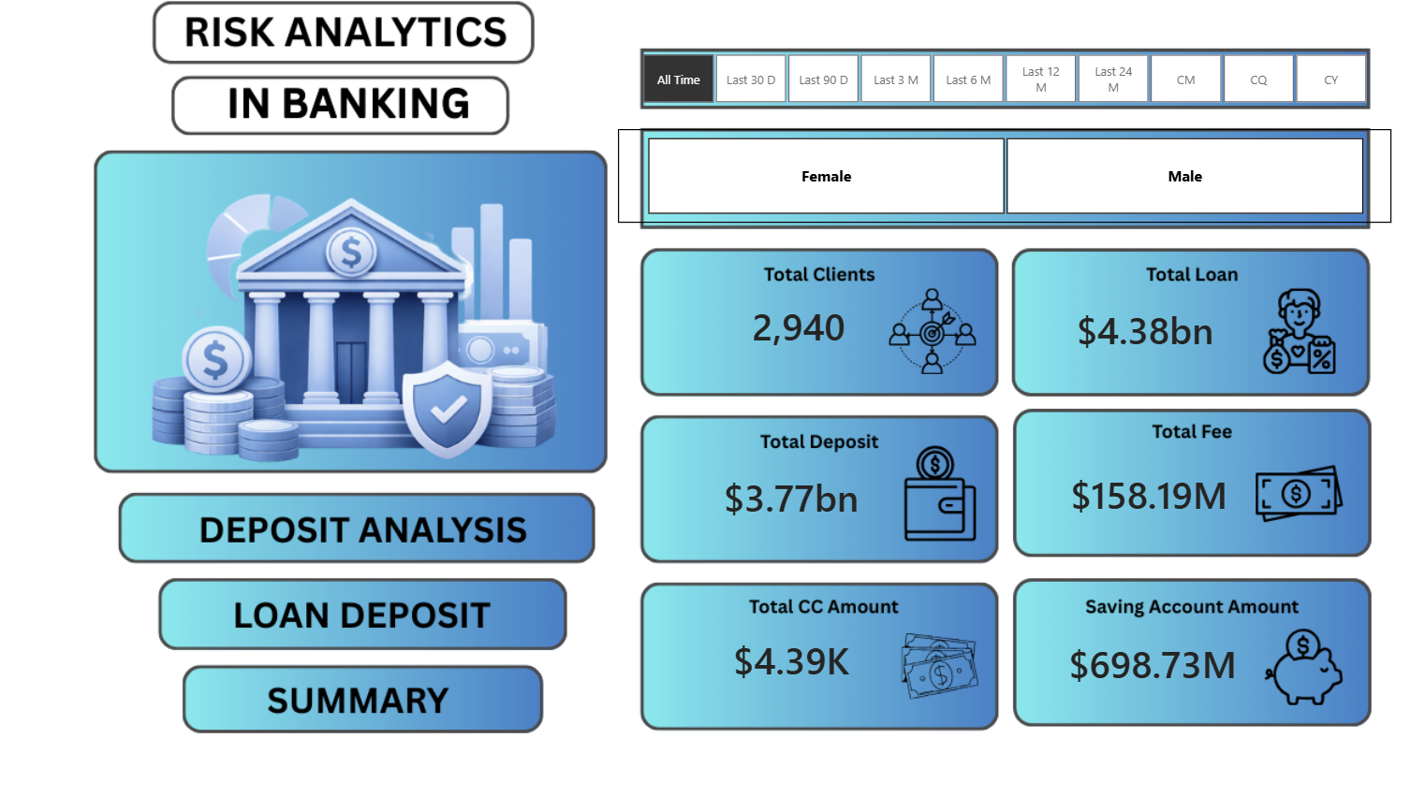
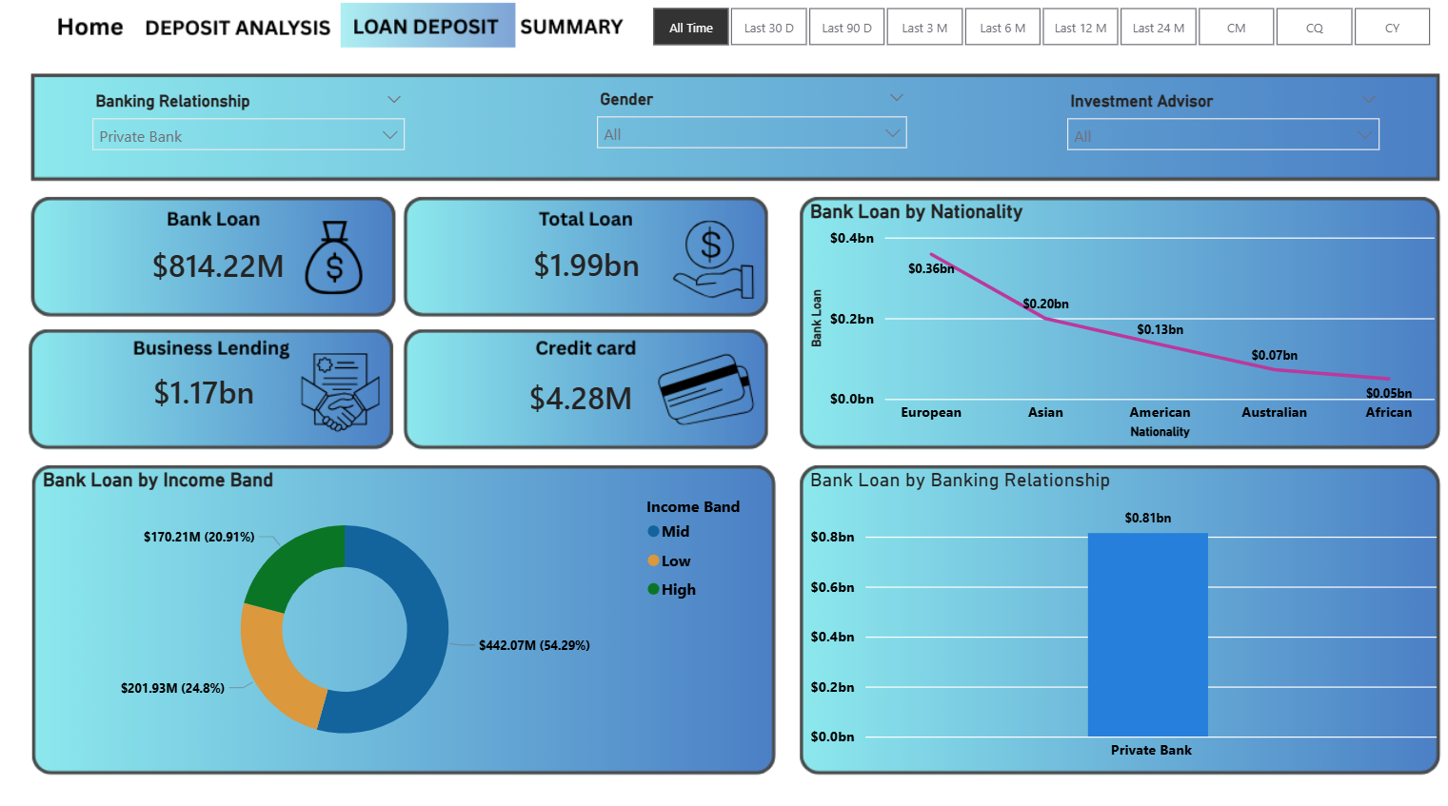
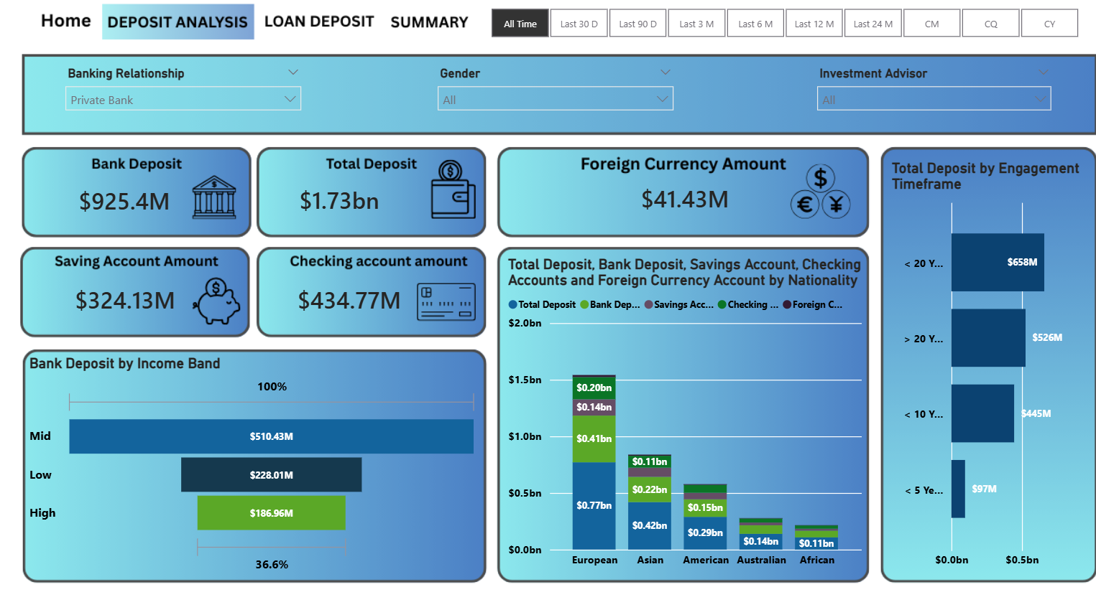

INTERACTIVE DASHBOARDS
Four Powerful Dashboard Views
There was an error generating this image
There was an error generating this image
Home Dashboard
Loan Analysis
Deposit Analysis
Summary Dashboard
Central hub displaying total clients (2,940), total loans ($4.38bn), total deposits ($3.77bn), and total fees ($158.19M) with gender-based filtering and time period selection.
Detailed breakdown of bank loans ($814.22M), business lending ($1.17bn), and credit cards ($4.28M) by nationality and banking relationship, with European clients leading at $0.36bn.
Comprehensive view of deposits by income band (Mid: $510.43M, Low: $228.01M, High: $186.96M) and engagement timeframe, with nationality-based segmentation.
Complete overview of all 12 KPIs including total clients (1,333), loans, deposits, fees, and account amounts, providing a holistic view of banking operations.

Slide 9



Key Insights & Strategic Value
Our Power BI dashboards deliver actionable intelligence that transforms banking operations. The data reveals critical patterns and opportunities for strategic decision-making.
Investor Intelligence
Banks can instantly access complete loan amounts and financial profiles for any investor, enabling rapid risk assessment and personalized service.
Competitive Strategy
Private banks dominate with the highest client counts. Other banking institutions can leverage these insights to develop targeted strategies for client acquisition.
Nationality Patterns
European clients represent the largest loan segment at $0.36bn, followed by Asian ($0.20bn) and American ($0.13bn) clients, informing market focus and resource allocation.

Slide 10

FUTURE VISION
Conclusion & Future Opportunities
Proven Impact
Future Enhancements
Power BI dashboards represent one of the most effective resources for the banking sector, transforming complex data into clear, actionable insights for risk management and strategic planning.
Predictive analytics for loan default probability
Real-time fraud detection algorithms
Customer lifetime value modeling
Automated risk scoring systems
Integration with external credit bureaus
Machine learning for pattern recognition
By empowering banks with comprehensive visibility into client relationships, account types, and financial behaviors across nationalities and demographics, these dashboards minimize lending risk while maximizing operational efficiency and customer satisfaction.

